Slide 1
Movie Database Project
By: Leonardo and Armaan

Slide 2
Table of Contents
01
02
03
04
Introduction
ER Diagram and Relational Schema
DDL and DML
User Interface

Slide 3
01
Introduction

Slide 4
What is the Movie Database Project about?
It is a database designed to efficiently store, manage, and retrieve detailed information about movies, directors, studios, genres, actors, and user ratings.

Slide 5
Movie – Stores movie information such as title, release date, runtime, synopsis, and links to director, studio, and genre.
Director – Stores information about directors, including name and birthdate.
Studio – Contains studio names and foundation years.
Genre – Lists all possible movie genres.
Actor – Stores actor names and birthdates.
MovieActor – Associative table representing the many-to-many relationship between movies and actors; includes role names.
UserAccount – Stores registered users who can rate movies.
Rating – Stores user ratings for movies and rating dates.
Entities and Roles

Slide 6
Web Applications and Dashboards – Display movies with director/studio names, average ratings, and actor lists.
Movie Recommendation Systems – Use ratings and genre information to suggest movies to users.
Analytics and Reporting – Generate insights like top-rated movies, most active actors, or genre trends.
Administrative Management – Help studios or film festivals manage movie metadata, personnel, and user feedback efficiently.
Practical Uses

Slide 7
02
ER Diagram

Slide 8
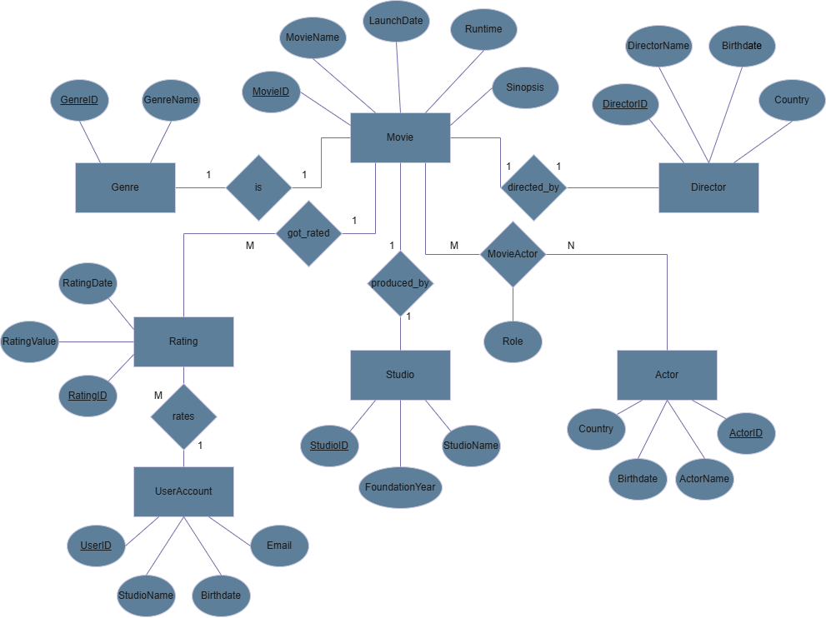
ER Diagram

Slide 9
03
Relational Schema

Slide 10
Relational Schema
Movie(MovieID, MovieName, LaunchDate, Runtime, GenreID, StudioID, DirectorID, Synopsis)
Studio(StudioID, StudioName, FoundationYear)
Director(DirectorID, DirectorName, Birthdate, Country)
Genre(GenreID, GenreName)
Actor(ActorID, ActorName, Birthdate, Country)
MovieActor(MovieID, ActorID, RoleName)
Rating(RatingID, MovieID, RatingValue, UserID, RatingDate)
UserAccount (UserID, Username, Email, Birthdate)

Slide 11
04
DDL and DML

Slide 12
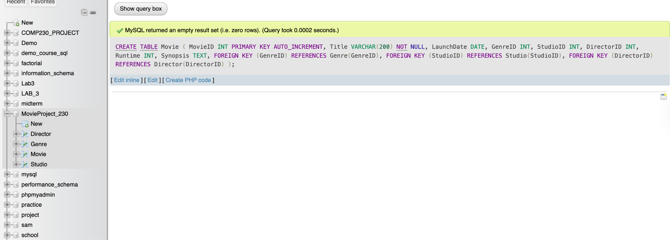
Example Cases of DDL Implementation

Slide 13
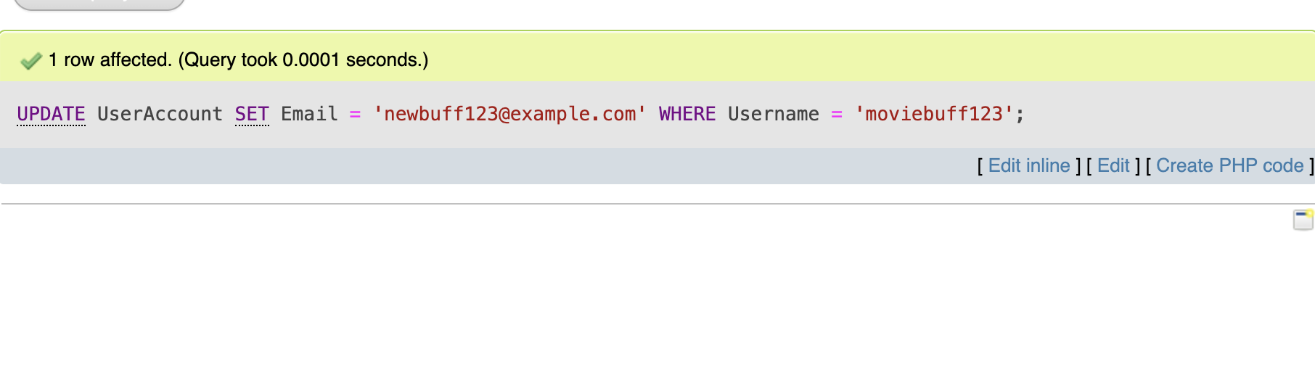
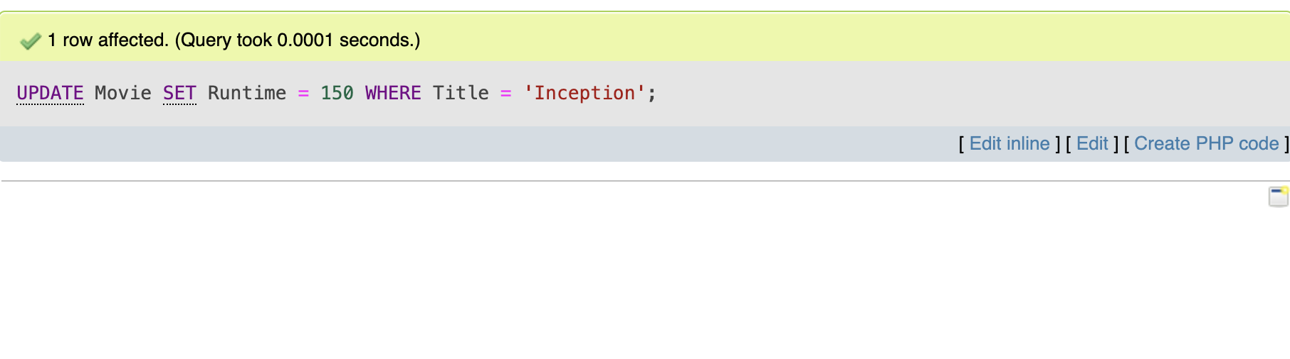
DML Example Case for UPDATE

Slide 14
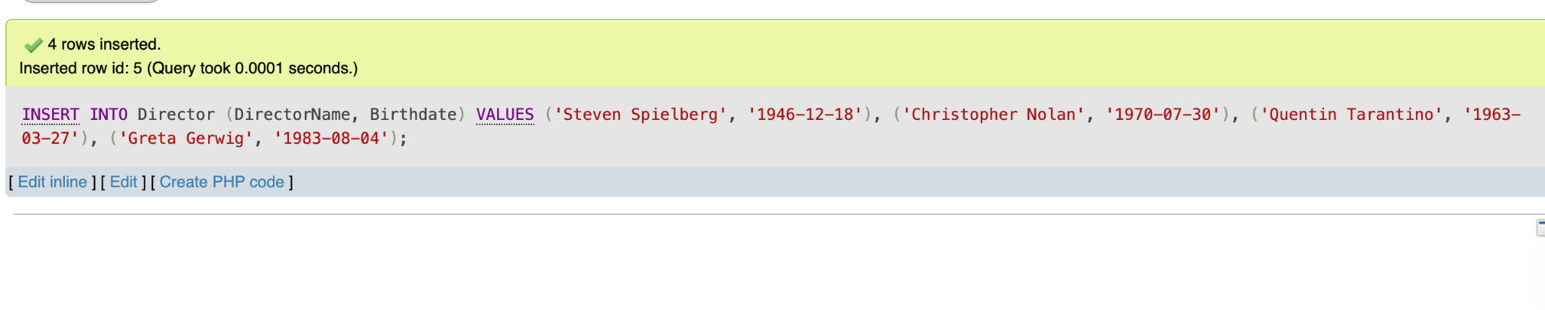
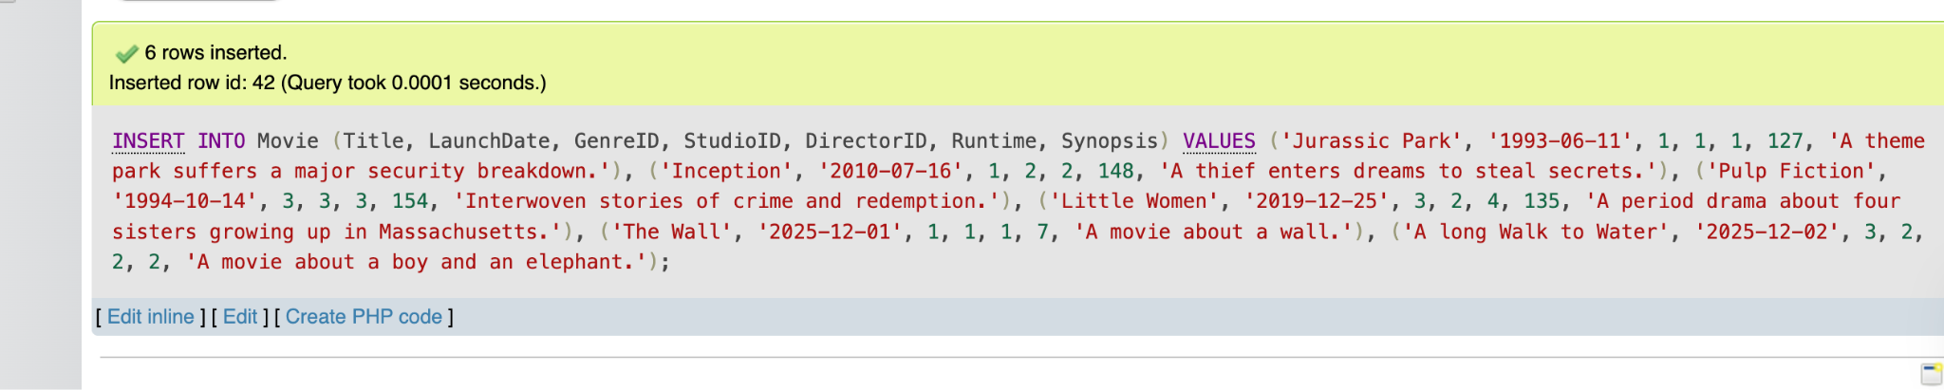
DML Example Case for INSERT

Slide 15
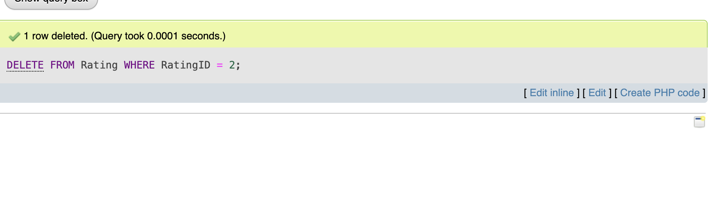
DML Example Case for DELETE

Slide 16
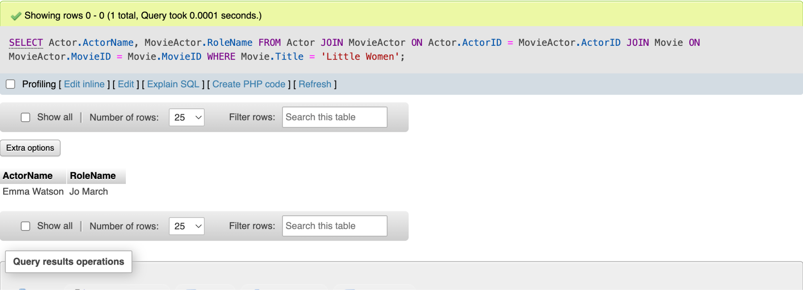
DML Example Case for SELECT

Slide 17
05
User Interface

Slide 18
References
Vicode Media. (2020, February 26). How to create foreign key in phpMyAdmin [Video]. YouTube. https://www.youtube.com/watch?v=7HTAX0dfJqg
Ismail, El Sayed. (2025). Week 2 – Database Design using ERD [PowerPoint slides]. BrightSpace.
Ismail, El Sayed. (2025). Week 3 – ERD & Relational Model [PowerPoint slides]. BrightSpace.
Ismail, El Sayed. (2025). Week 4 – Relational Model & SQL [PowerPoint slides]. BrightSpace.
Ismail, El Sayed. (2025). Week 5 – Referential Integrity Constraints Part 2 [PowerPoint slides]. BrightSpace.
The SQL Guy. (2023b, July 31). The Count Function SQL Tutorial [Video]. YouTube. https://www.youtube.com/watch?v=AiIgdJka-Mg

Slide 19
Thank You!

Slide 20
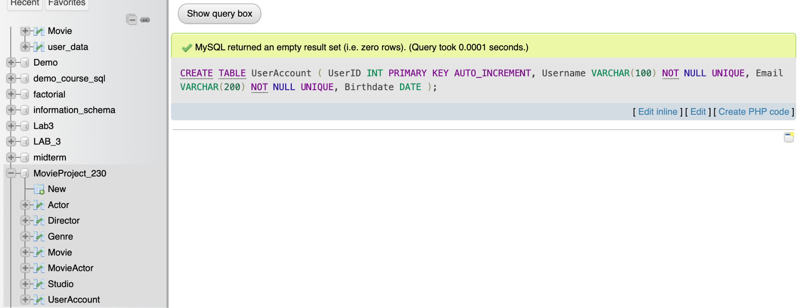
Additional DDL Queries

Slide 21
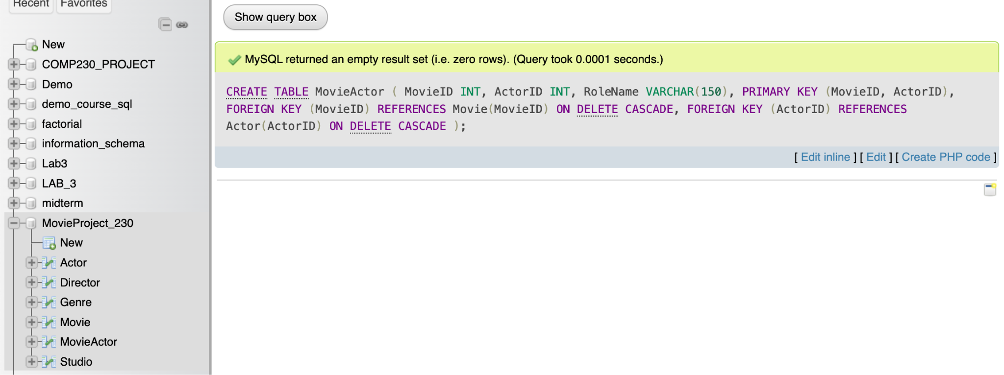
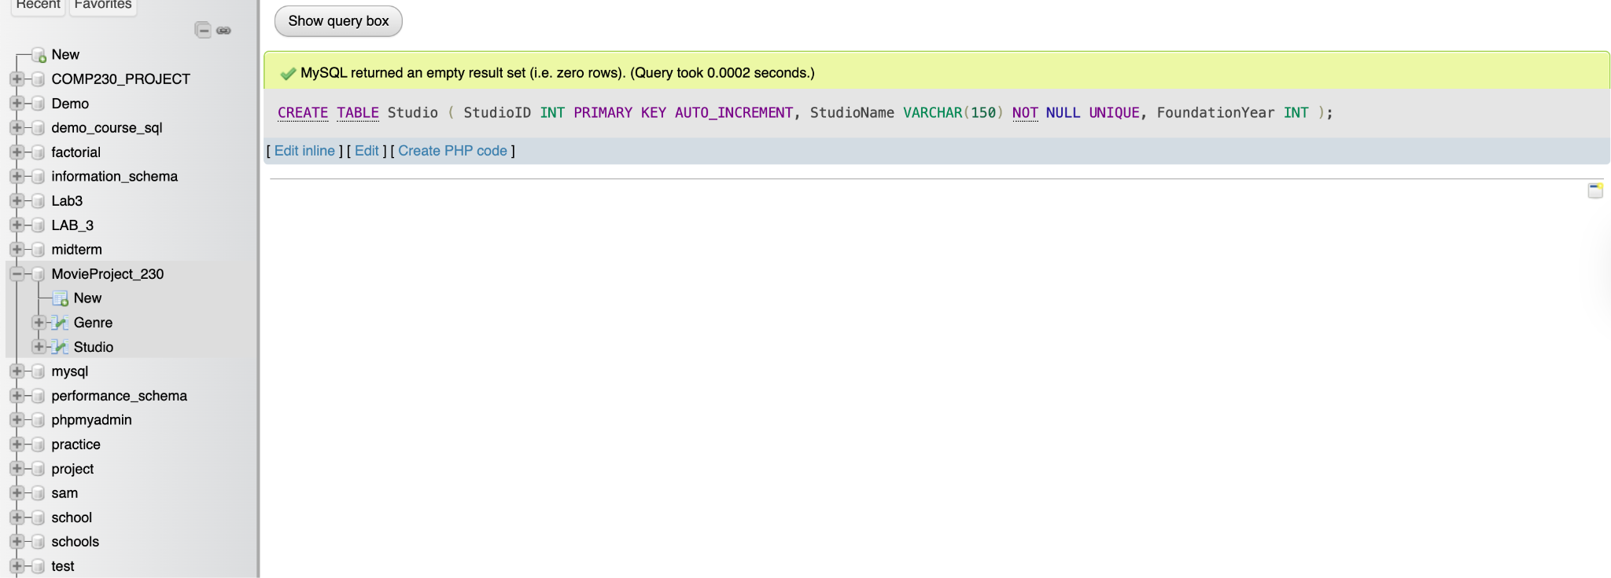
Additional DDL Queries

Slide 22
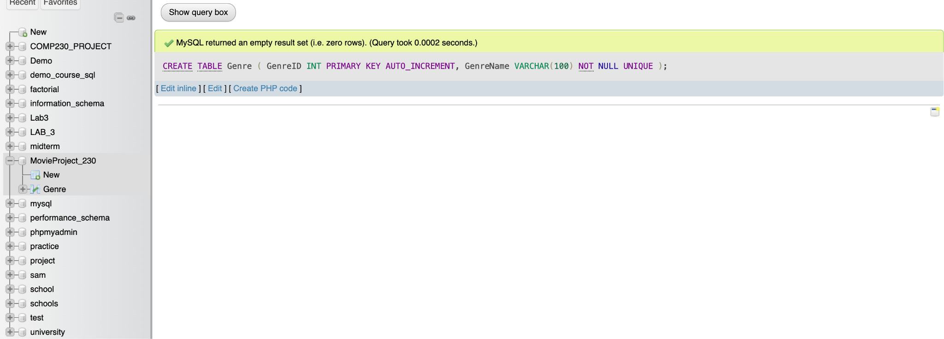
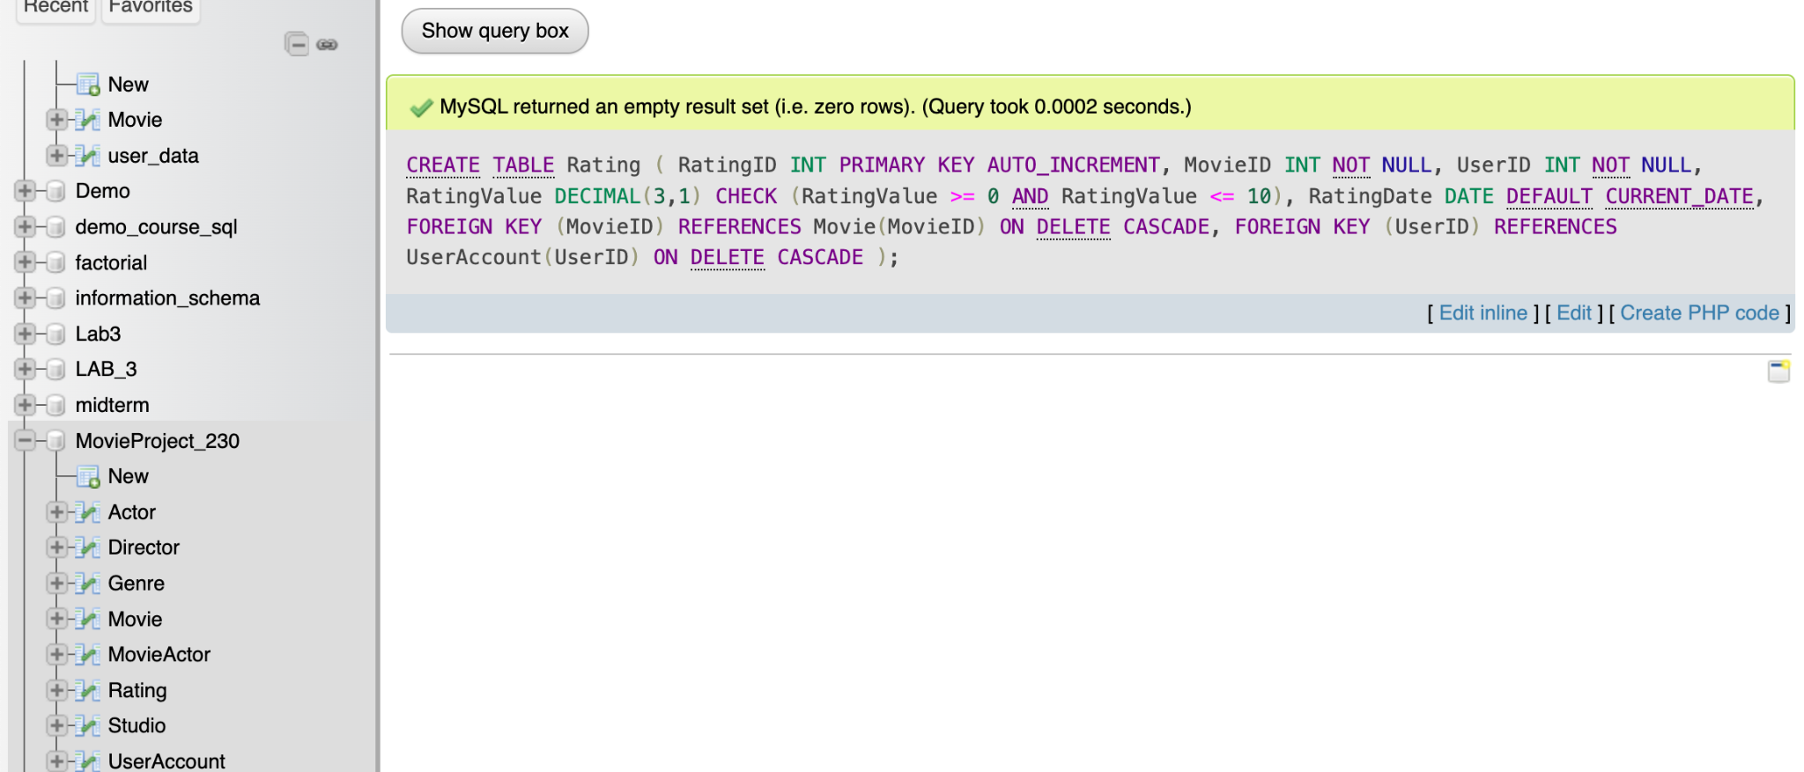
Additional DDL Queries

Slide 23
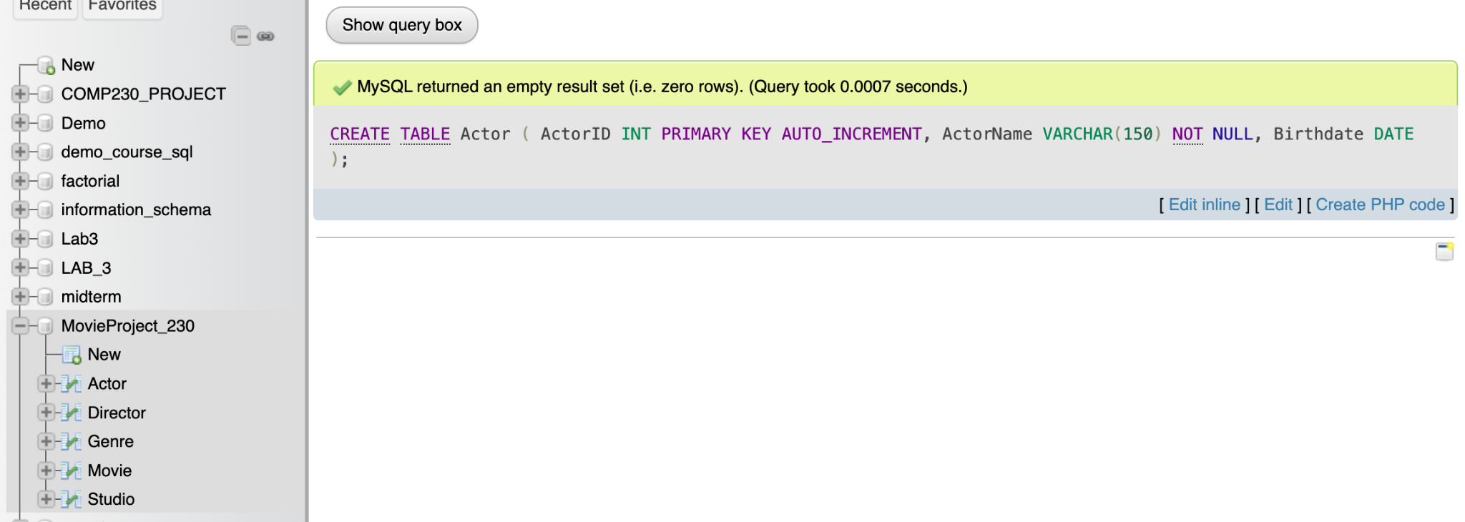
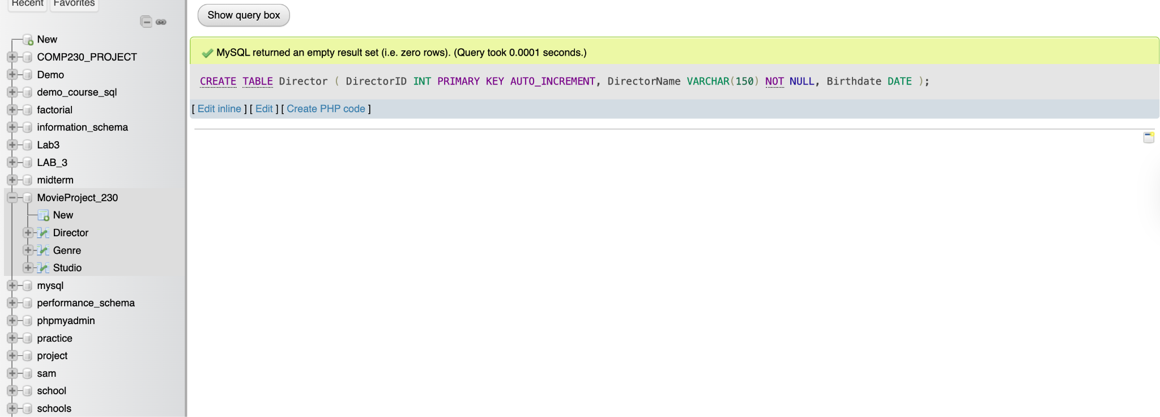
Additional DDL Queries

Slide 24
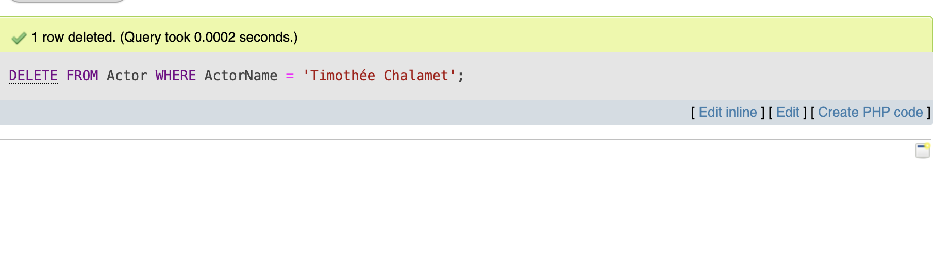
Additional DML Queries (DELETE)

Slide 25
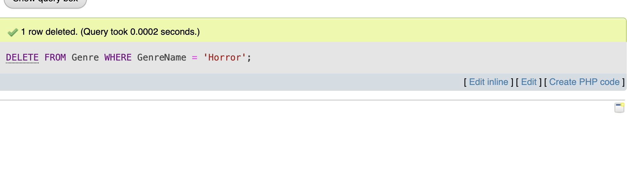
Additional DML Queries (DELETE)

Slide 26
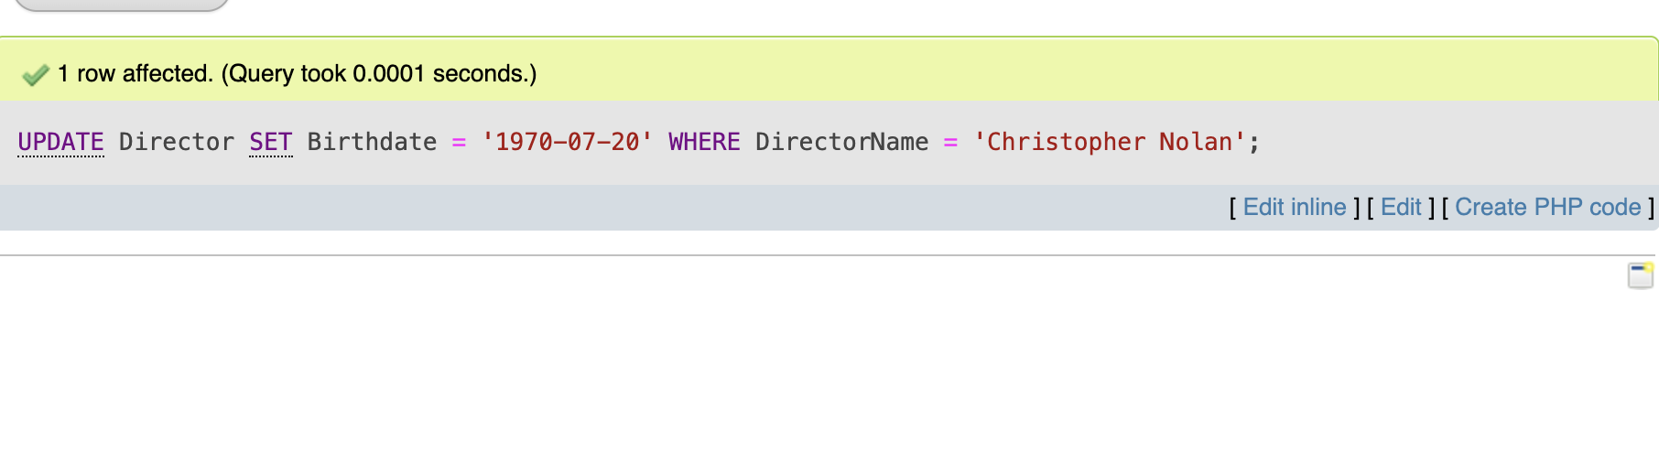
Additional DML Queries (UPDATE)

Slide 27
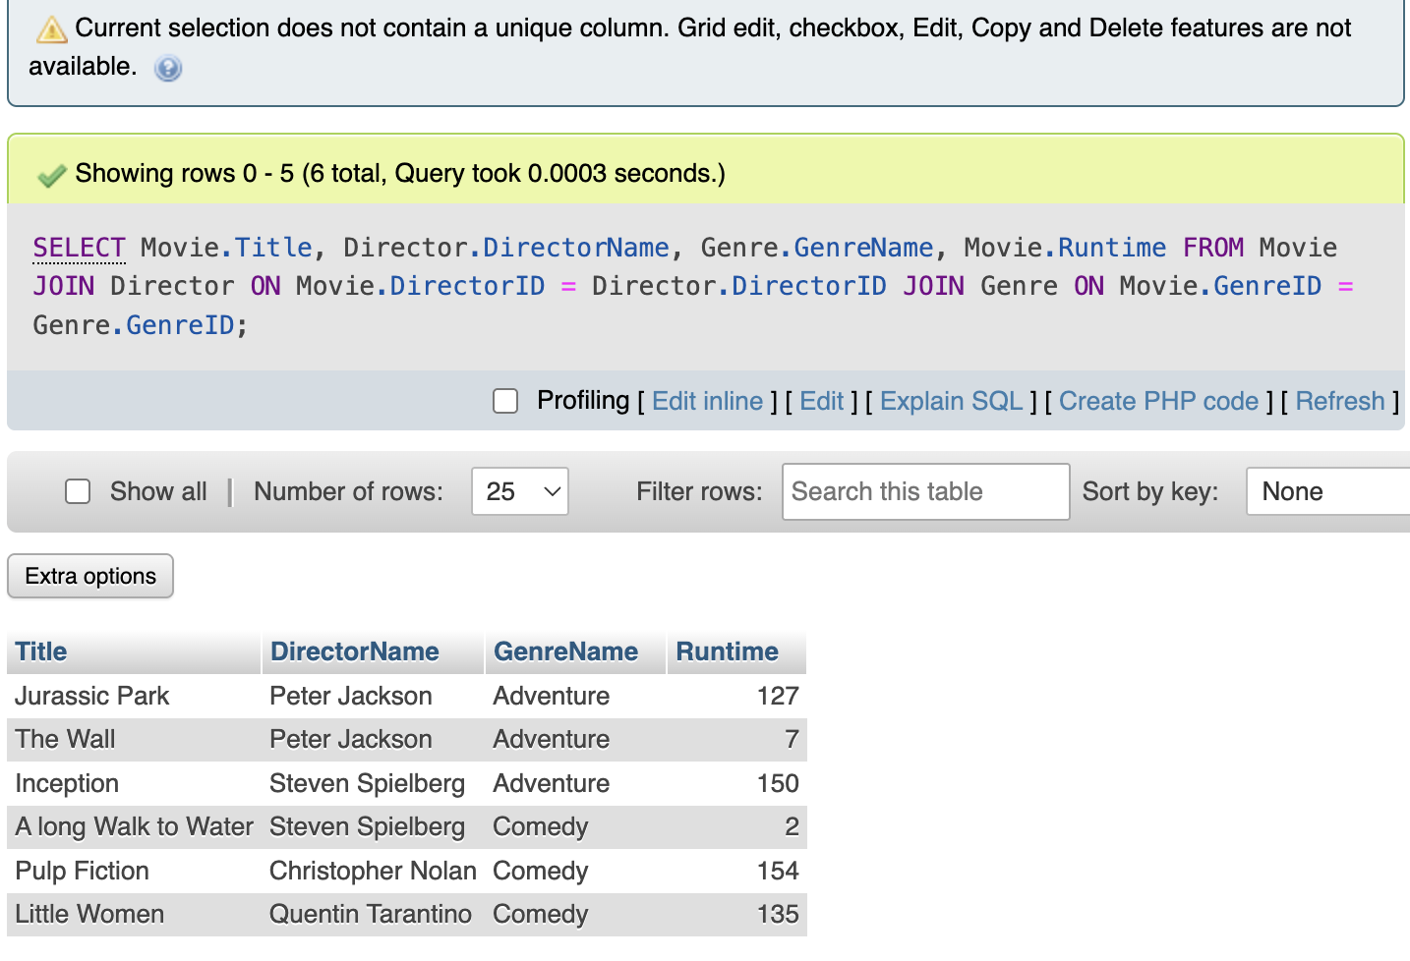
Additional DML Queries (SELECT)

Slide 28
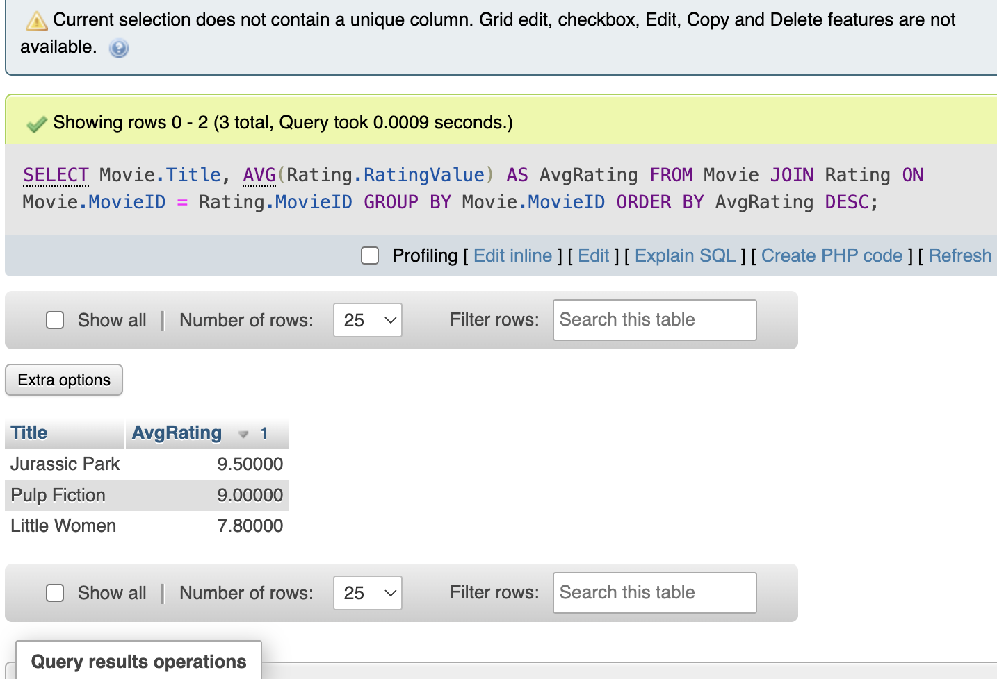
Additional DML Queries (SELECT)

Slide 29
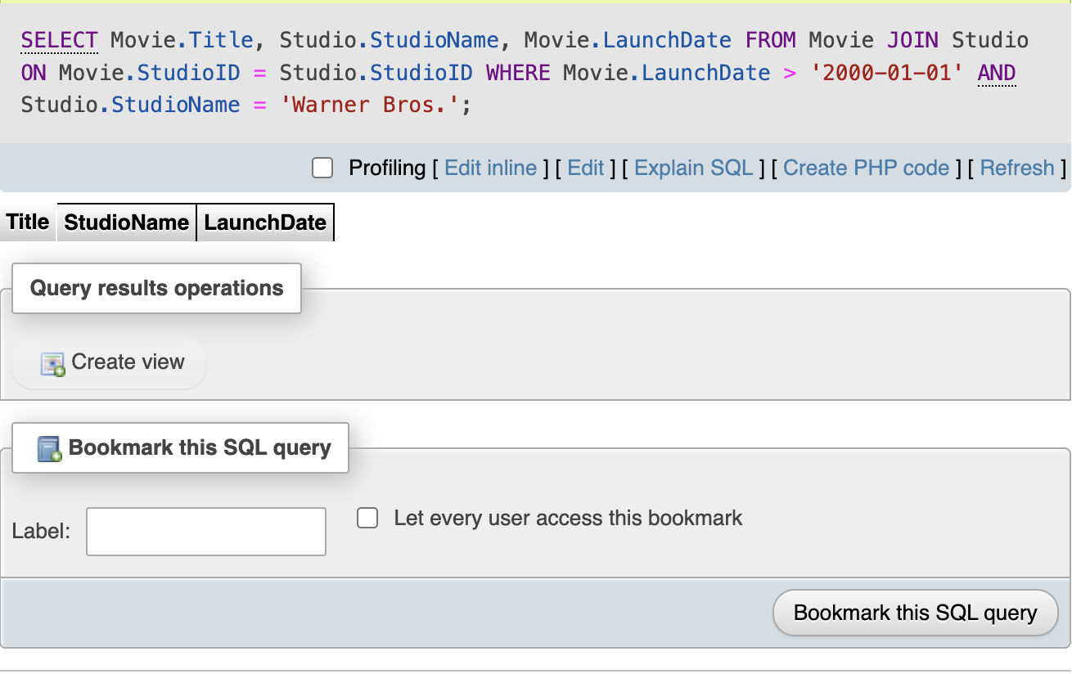
Additional DML Queries (SELECT)

Slide 30
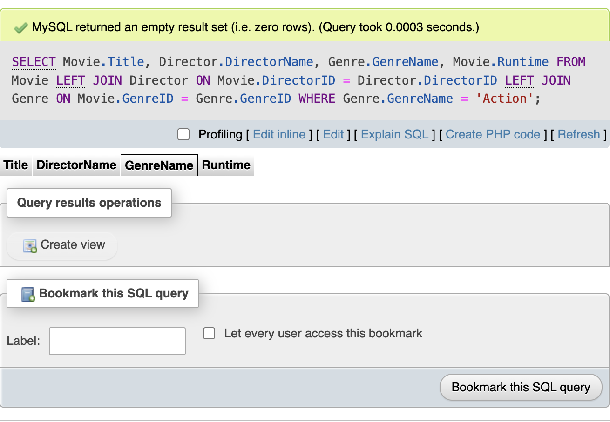
Additional DML Queries (SELECT)

Slide 31
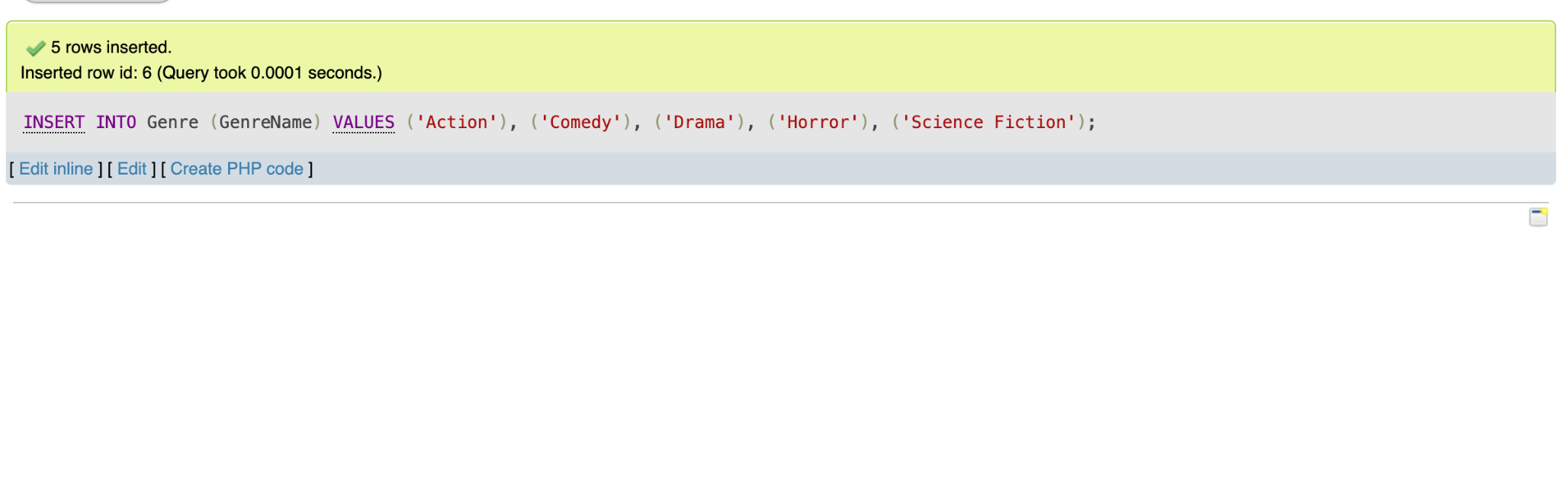
Additional DML Queries (INSERT)

Slide 32
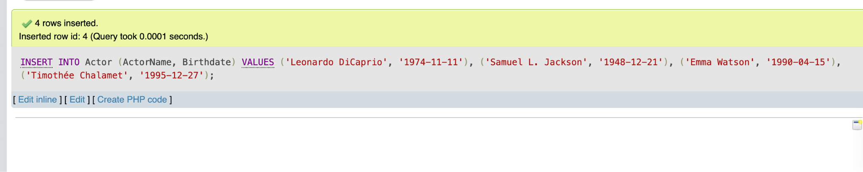
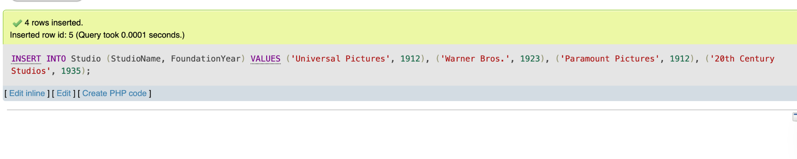
Additional DML Queries (INSERT)

Slide 33
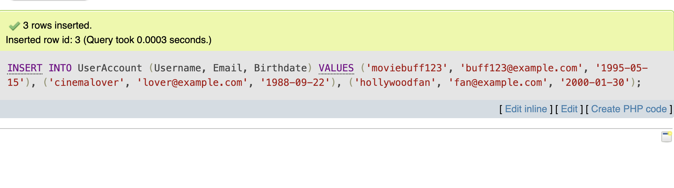
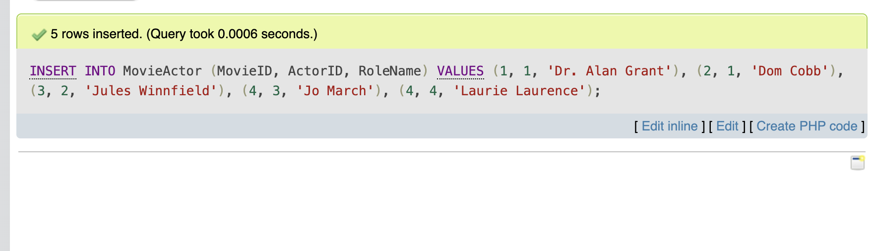
Additional DML Queries (INSERT)

Slide 34
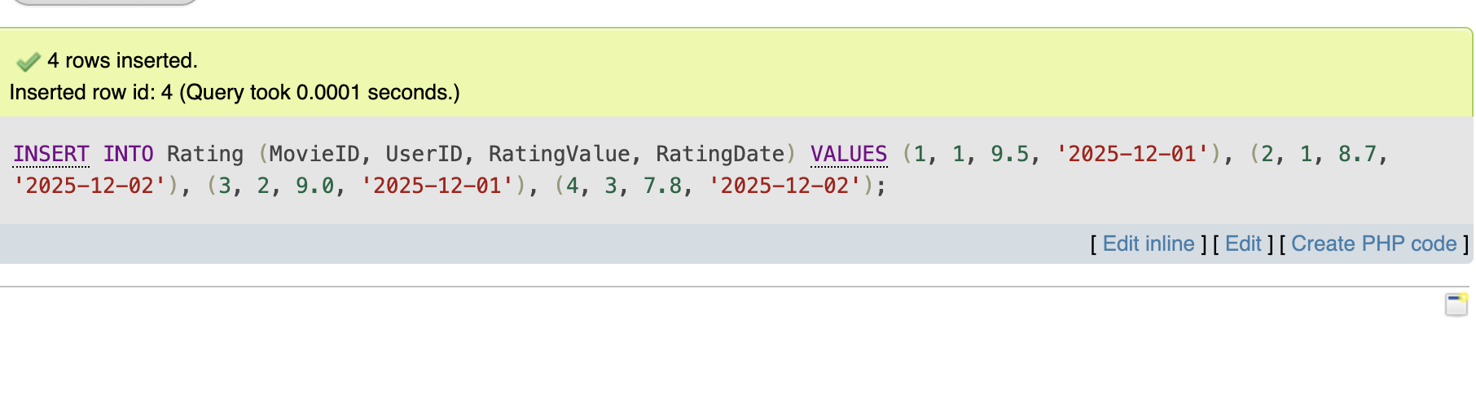
Additional DML Queries (INSERT)

